Slide 1
10 SQL Server Wait Types Everyone Should Know
Janis Griffin
Performance Evangelist / Senior DBA

Slide 2
Who Am I?
Database Performance Evangelist for Solarwinds
Janis.Griffin@solarwinds.com
Twitter - @DoBoutAnything
Current – 25+ Years in Sql Server, Sybase, Oracle
Lately MySQL ☺
DBA and Developer
Specialize in Performance Tuning
Review Database Performance
for Customers & Prospects
Common Thread – Paralyzed by Tuning

Slide 3
Agenda
What Are Wait Types
Wait Time Tables (DMVs - 2005 & Up)
Top 10 List of Wait Types
1. PAGEIOLATCH_*
2. WRITELOG
3. ASYNC_NETWORK_IO
4. CXPACKET
5. CPU
6. LCK_M_*
7. PREEMPTIVE_*
8. PAGELATCH_*
9. LATCH_*
10. IO_Completion Solutions
Several Solutions For Each
To Reduce Wait Time

Slide 4

What Are Wait Types
SQL Server is instrumented to give clues about what it’s doing
When processing SQL statements
Wait Types identify resources being used up or waited on
For each step taken by SQL statement
Also show where the latencies are occurring
Recording Wait Time and Wait Types = Wait Time Analysis
Locking issues have a different solutions than too many disk reads
SQL Server 2012 – 649 Wait Types
SQL Server 2014 – 800+ Waits
For a more complete description
Microsoft Waits and Queue Document (SQL 2005 but still relevant)
Wait Type Description - 2014 + 2005 thru 2012

Slide 5
Wait Time Tables (DMVs - 2005 & Up)
http://msdn.microsoft.com/en-us/library/ms188754.aspx
http://msdn.microsoft.com/en-us/library/ms188068.aspx
2014
_{dm_exec_requests}
_{start_time}
_{status}
_{sql_handle}
_{plan_handle}
_{start/stop offset}
_{database_id}
_{user_id}
_{blocking_session}
_{wait_type}
_{wait_time}
_{dm_os_wait_stats}
_{wait_type}
_{waiting_tasks_count}
_{wait_time_ms}
2000 only
_{sysprocesses}
_{loginame}
_{hostname}
_{programname}
_{spid}
_{dbid}
_{waittype}
_{waittime}
_{Lastwaittype}
_{waitresource}
_{sql_handle}
_{stmt_start}
_{stmt_end}
_{cmd}
_{dm_exec_sessions}
_{login_time}
_{login_name}
_{host_name}
_{program_name}
_{session_id}
_{dm_exec_sql_text}
_{text}
_{dm_exec_query_stats}
_{execution_count}
_{total_logical_writes}
_{total_physical_reads}
_{total_logical_reads}
_{dm_exec_query_plan}
_{query_plan}
5

Slide 6
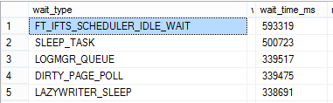
More about DMVs for Wait Types
sys.dm_os_wait_stats
Cumulative since instance startup
select * from sys.dm_os_wait_stats order by wait_time_ms desc;
Exclude idle wait types
View into what your whole instance is waiting on
sys.dm_exec_requests
Real-time view into what each session/SQL is waiting on
Status Column tells you what state it’s in
Suspended - means the session is waiting on the wait_type
Running/Runnable - means the session is on the CPU or in queue
Sleeping - means the session is idle
Example query – next slide

Slide 7
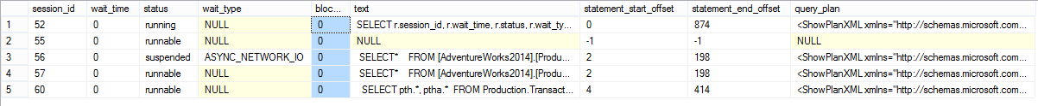
DM_EXEC_REQUESTS Query
SELECT r.session_id, r.wait_time, r.status, r.wait_type, r.blocking_session_id,
s.text, r.statement_start_offset, r.statement_end_offset, p.query_plan
FROM sys.dm_exec_requests r
OUTER APPLY sys.dm_exec_sql_text (r.sql_handle) s
OUTER APPLY sys.dm_exec_text_query_plan (r.plan_handle, r.statement_start_offset,
r.statement_end_offset) p
WHERE r.status <> ’background’
AND r.status <> ’sleeping’

Slide 8
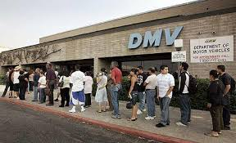
Wait Type DMV Problem
No Time Based View
What happened between 3am-5am this morning is not possible to get from the DMV objects
Need to use other tools
Run example query, include timestamp and save in table
Extended Events Session to gather waits and query results
System_health session gather SQLs / Waits – hard to see trends
Solarwinds Database Performance Analyzer (DPA) does a great job of trending both SQLs and Waits
Different DMV Problem

Slide 9
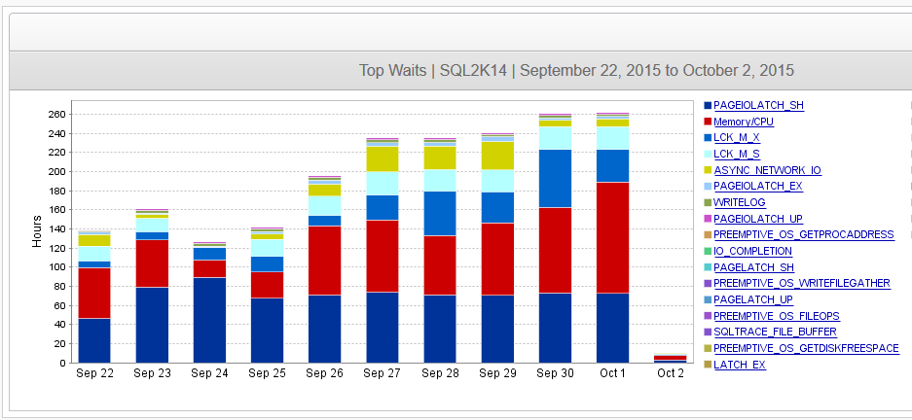
Top 10 List of Wait Types
There are only a few wait types you need to know well
The other 600+ you can Google or ask Microsoft
Need to know:
What causes these waits
How to reduce or fix these waits
This presentation discusses most common wait types I’ve personally encountered from over 500+ customers

Slide 10
1. PAGEIOLATCH_*
PAGEIO latches are used when the buffer and associated data or index page is in the middle of an IO operation. PAGEIOLATCH wait types are used for disk-to-memory transfers.
Where * in:
SH – shared: session reads the data
EX – exclusive: session needs exclusive access to page
UP – update: session needs to update data
DT – destroy: session needs to remove the page
KP – keep: temporary while SQL Server decides
NL – undocumented
The SH, EX and UP latches are by far the most common

Slide 11
1. PAGEIOLATCH_* Solutions
Do fewer disk reads
Tune the SQL statement to do less I/O
Are you reading/writing way too much data
Try to find the best ‘driving’ table
Get the least amount of data first, then build upon it
Cache more data
Create a bigger buffer cache so disk reads not needed
If many SQLs waiting – bigger cache may help
If few SQLs waiting – probably means SQL tuning
Use query below to check MB per Second
select db_name(database_id) db_name, FILE_NAME(file_id) file_name,
num_of_reads, num_of_bytes_read / 1048576.0 / sample_ms*1000 read_mb_per_sec,
io_stall_read_ms / case num_of_reads when 0 then 1 else num_of_reads end as read_latency,
num_of_writes, num_of_bytes_written / 1048576.0 / sample_ms*1000 write_mb_per_sec,
io_stall_write_ms / case num_of_writes when 0 then 1 else num_of_writes end as write_latency
from sys.dm_io_virtual_file_stats (null, null)

Slide 12
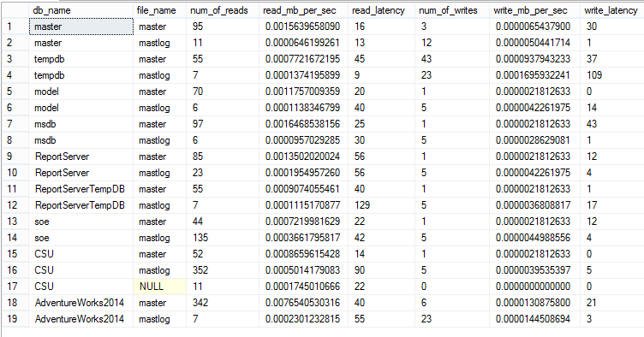
1. PAGEIOLATCH_* Solutions – Cont.
Check file/disk latency
Anything higher than ~15 ms is considered slow
Especially on production class servers
Overloaded disk? Talk to storage team
Remember there are many layers between the database and storage
O/S, Virtualization,Network, etc.

Slide 13
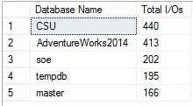
1. PAGEIOLATCH_* Solutions – Cont.
DMF - sys.dm_io_virtual_file_stats
I/O stats since SQL Server Startup
sys.dm_io_virtual_file_stats(@database_id,@file_id)
Can pass (NULL, NULL) to get all databases, all files
Get the top 5 databases with most I/O
SELECT TOP 5 DB_NAME(database_id) AS Database Name,
SUM(num_of_reads + num_of_writes) AS Total I/Os
FROM sys.dm_io_virtual_file_stats (NULL,NULL)
GROUP BY database_id
ORDER BY SUM(num_of_reads + num_of_writes) DESC
Or Top 5 files with most I/O
SELECT TOP 5 FILE_NAME(file_id) file_name … GROUP BY file_id

Slide 14
1. PAGEIOLATCH_* Solutions – Cont.
Capture baselines & compare over time
If volume of waits not changing but duration is longer
Review I/O Subsystem for misconfiguration or any errors
Look at network latency
Evaluate other I/O workload
Review configuration of synchronous activities (i.e. replication/mirroring)
Other reasons for large amounts of I/Os
Plan cache bloat
Causes extra memory to be borrowed from buffer pool
Windows memory pressure on SQL Server
Causes the memory manager to reduce buffer pool size
Parallel Queries doing full table or clustered index scans
Look for large amounts of CXPACKET waits
Along with PAGEIOLATCH_SH waits
Query sys.dm_os_waiting_tasks or sys.dm_os_wait_stats

Slide 15
2. WRITELOG
Waiting for a log flush to complete
Represents the time a log block in memory is flushed to disk
Commonly occurs because of checkpoint or commit
Commits can be explicit (commit) or implicit (auto-commit)
EXAMPLE - Inserted 70,000 rows in 10:08 vs. 0:28
DECLARE @i INT
SET @i = 1
BEGIN TRANSACTION
WHILE @i < 70000
BEGIN
INSERT INTO jpetstore.dbo.product(
productid,
category,
name,
descn)
VALUES (@i,
floor(@i / 1000),
'PROD' + REPLACE(str(@i),' ',''),
'PROD' + REPLACE(str(@i),' ',''))
SET @i = @i + 1
COMMIT
END
DECLARE @i INT
SET @i = 1
BEGIN TRANSACTION
WHILE @i < 70000
BEGIN
INSERT INTO jpetstore.dbo.product(
productid,
category,
name,
descn)
VALUES (@i,
floor(@i / 1000),
'PROD' + REPLACE(str(@i),' ',''),
'PROD' + REPLACE(str(@i),' ',''))
SET @i = @i + 1
END
COMMIT

Slide 16
2. WRITELOG Solutions
Do less work
Develop code to do more batch processing
Avoid single row processing inside loop
Better to do set based processing
Make disk writes faster
Avoid RAID5/6 – write I/O penalty
Check file/disk latency with sys.dm_io_virtual_file_stats DMF
Response time on log disks should be <1ms – 5ms
Review the write latencies for the transaction logs
Reduce I/O contention on disks containing logs
Consider SSDs for your log files
Several test cases have seen good results

Slide 17
2. WRITELOG Solutions – CONT.
Make disk writes faster
Size the transaction logs properly
Full Recovery Model but log backups are disabled
Slow Database Mirroring
Transactional Replication – Log Reader Agent job can’t keep up
http://sqlmag.com/blog/sizing-your-transaction-log
Transaction Log Management
Full or Simple Recovery Model?
Or a combination
http://www.sqlskills.com/blogs/paul/importance-of-proper-transaction-log-size-management/
Review Perfmon counters & Baseline
Log Bytes Per Flush | Number of bytes in the log buffer when the buffer is flushed.
Log Flushes/sec | Number of log flushes per second.
Log Flush Wait Time | Total wait time (milliseconds) to flush the log.
Log Flush Waits/sec | Number of commits per second that are waiting on log flush.

Slide 18
3. ASYNC_NETWORK_IO
Query produces result set & sends back to client
While client processes data, SQL Server process waits
Often caused by large result sets being returned
Application that queries every row from large tables
MS Access joins SQL Server data to Access data
Access must read all data in SQL table to join / filter in Access
No WHERE clause - Select * from <large table>;
Can also apply to linked server queries
Slow client processing
Client machine is very busy so not processing results quickly
Client is reading data from SQL, then processing it on client which is slow
Could be a slow network connection from client to server
Orphaned SQL Server processes

Slide 19
3. ASYNC_NETWORK_IO Solutions
Limit the result sets
Poorly written applications read data from entire table then filter at client.
Filter on database first or write rows to temp table then have client read temp data
Avoid joins across Access to SQL Server data.
This also applies to Linked Server and other distributed queries
Check performance of client machine
If it’s resource constrained, it’s slowing down the processiong
Check logic of client application
Avoid retrieving large result sets if possible
Do more result set processing in database
Check the speed & stability of the network
Between client and server
Check for orphaned SQL Server Processes
End users not logging out of application / shutting down browsers

Slide 20
4. CXPACKET
Indicates a SPID is waiting on parallel processes to complete or start
It’s more of a status - not necessarily a problem
May be very normal for data warehouse queries
Less so for OLTP operations (especially if it has lots of time)
Master process will farm work out to slave processes
Then wait on CXPACKET until all slaves have completed
SQL Server will try to parallelize big queries up to MAXDOP
Can be set instance-wide or for a specific query
MAXDOP = 0 by default meaning unlimited
Recommendation:
http://support.microsoft.com/kb/2806535
MAXDOP should not be set higher than 8 in most cases

Slide 21
4. CXPACKET - More Info
Need to understand the slave processes
What are they doing / waiting for
Use sys.dm_os_waiting_tasks
select session_id, exec_context_id, wait_type, wait_duration_ms, resource_description
from sys.dm_os_waiting_tasks
where session_id in (
select session_id from sys.dm_exec_requests
where wait_type='CXPACKET')
order by session_id, exec_context_id
Example Output
session_id exec_context_id wait_type wait_duration_ms resource_description
64 0 CXPACKET 417920
64 1 PAGEIOLATCH_SH 149 5:1:1358830
64 2 PAGEIOLATCH_SH 368 5:1:3514639
64 3 PAGEIOLATCH_SH 84 5:1:3484089
In this case, tune PAGEIOLATCH_SH waits

Slide 22
4. CXPACKET Solutions
Tune MAXDOP according to KB article provided
Not all queries do well in parallel
Experiment with MAXDOP settings at SQL level
A lot of bad advice about reducing MAXDOP server wide
Avoid making blanket or covering changes
Tune the waits of the parallel slave process waits
Review previous slide
Inefficient, costly queries that reads lots of data
SQL Server will parallelize them due to cost
Tune the queries to read less data
Review data skew and bad statistics
Can cause one or few slave processes to do the bulk of the work

Slide 23
5. CPU
CPU is NOT a wait type
It identifies time spent on CPU or on CPU queue
Query Response Time =
Wait Time (wait types) + Service Time (CPU)
Waiting on CPU when sys.dm_exec_request has:
status = running
wait_type is often null
wait_time = 0
CPU time is often spent doing logical I/O
Reading memory
Could also come from compiles/recompiles
Other CPU intensive operations

Slide 24
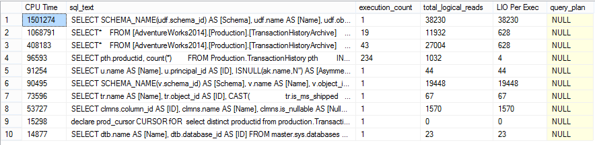
5. CPU Solutions
Tune queries with high amount of CPU time
Which often have high logical I/O
SELECT TOP 10 total_worker_time CPU Time,
SUBSTRING(st.text, (qs.statement_start_offset/2)+1,
((CASE qs.statement_end_offset
WHEN -1 THEN DATALENGTH(st.text)
ELSE qs.statement_end_offset
END - qs.statement_start_offset)/2) + 1) AS sql_text,
qs.execution_count, qs.total_logical_reads,
qs.total_logical_reads/qs.execution_count LIO Per Exec, qp.query_plan
FROM sys.dm_exec_query_stats AS qs
OUTER APPLY sys.dm_exec_sql_text(qs.sql_handle) AS st
OUTER APPLY sys.dm_exec_query_plan (qs.sql_handle) qp
ORDER BY total_worker_time DESC

Slide 25
5. CPU Solutions – CONT.
Reduce high execution count queries –
Do more batch processing
Tune high logical I/O queries
Unnecessary reading can cause thrashing of memory
Thus more work for the CPU
Check for CXPACKET waits
MAXDOP unlimited?
Review KB article on CXPACKET slide
Check O/S for other activity putting pressure on CPU
May see high CPU queue lengths
Is the hardware undersized
May need to purchase larger/faster servers

Slide 26
6. LCK_M_*
Occurs when a session holds a lock on a resource and other sessions attempt to acquire conflicting locks on the same resource
Where * is 21 different possibilities - most common are:
U – trying to update the same resource
S – trying to modify data while it is being read
X – trying to lock a resource exclusively
IU, IS, IX – indicates intent to lock
SCH – schema locks – object is changing underneath
In SQL Server, writers can block readers
Not to be confused with deadlocks
Special locking case
https://support.microsoft.com/en-us/kb/224453

Slide 27
6. LCK_M_* - more Info
A session waiting on LCK_M_* wait is the victim
Need to get blocking_session_id to see the root cause
Many ways to see blocker / blockee
EXEC sp_who2
DMVs - sys.dm_tran_locks, sys.dm_os_waiting_tasks.
Query on sys.dm_exec_requests
select r1.session_id, SUBSTRING(s1.text, (r1.statement_start_offset/2)+1,
((CASE r1.statement_end_offset
WHEN -1 THEN DATALENGTH(s1.text)
ELSE r1.statement_end_offset
END - r1.statement_start_offset)/2) + 1) AS blocked_sql_text,
r1.blocking_session_id, SUBSTRING(s2.text, (r2.statement_start_offset/2)+1,
((CASE r2.statement_end_offset
WHEN -1 THEN DATALENGTH(s2.text)
ELSE r2.statement_end_offset
END - r2.statement_start_offset)/2) + 1) AS blocker_sql_text,
r1.wait_resource
from sys.dm_exec_requests r1
left outer join sys.dm_exec_requests r2 on r1.blocking_session_id = r2.session_id
outer apply sys.dm_exec_sql_text (r1.sql_handle) s1
outer apply sys.dm_exec_sql_text (r2.sql_handle) s2
where r1.blocking_session_id > 0

Slide 28
6. LCK_M_* - more Info
Another blocker / blockee query
SELECT db.name DBName, tl.request_session_id, wt.blocking_session_id, OBJECT_NAME(p.OBJECT_ID) BlockedObjectName, tl.resource_type, tl.resource_description,
h1.TEXT AS RequestingText, h2.TEXT AS BlockingTest, tl.request_mode
FROM sys.dm_tran_locks AS tl INNER JOIN sys.databases db ON db.database_id = tl.resource_database_id INNER JOIN sys.dm_os_waiting_tasks AS wt
ON tl.lock_owner_address = wt.resource_address LEFT OUTER JOIN sys.partitions AS p ON p.hobt_id= tl.resource_associated_entity_id INNER JOIN sys.dm_exec_connections c1
ON c1.session_id = tl.request_session_id INNER JOIN sys.dm_exec_connections c2 ON c2.session_id = wt.blocking_session_id
CROSS APPLY sys.dm_exec_sql_text(c1.most_recent_sql_handle) AS h1 CROSS APPLY sys.dm_exec_sql_text(c2.most_recent_sql_handle) AS h2

Slide 29
6. LCK_M_* Solutions
To understand the locked resource, review the wait_resource
Technical-microsoft-sql-server-wait-resource
Wait_resource data
Usually in 3 or 4 parts separated by colons
Example: 8:3:14480:0
1st number is the database_id
select db_name(8)
2nd number is the file number
select * from sys.database_files where file_id=1
3rd page number – see below to get details of that page
dbcc traceon (3604)
go
dbcc page (8, 3, 4111532)
Get ObjectID from output
select * from sys.objects where object_id=1615774005
4th is slot or row number

Slide 30
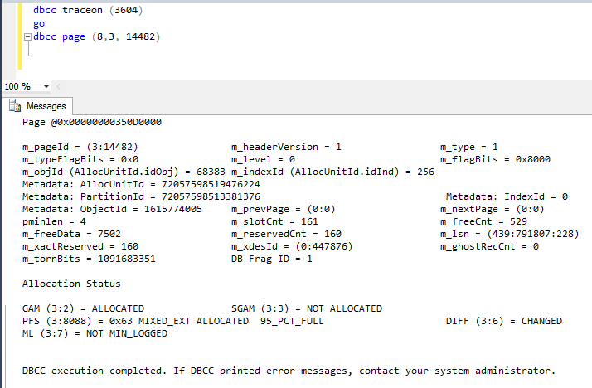
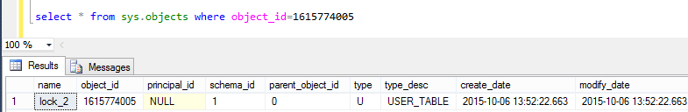
6. LCK_M_* Solutions

Slide 31
6. LCK_M_* Solutions
Review the blocking session
Understand the relationship with the blocked queries
Does the application need to be redesigned?
Blocking issues are often caused by a session holding locks for longer than necessary
Does the blocking session go on to do a lot of other SQLs?
Check to see if the transactions can be committed sooner
Keep transactionds small
Is the blocking session executing inefficient SQLs while holding locks?
Tuning the query could reduce the blocking time
Has the client process been terminated due to timeouts?
The SQL Server process could be left behind (orphaned) and never go away.
Terminating the session should release the locks
Is the client not fetching the whole result set quickly enough?
See the ASYNC_NETWORK_IO wait description.
Is the session in ROLLBACK state?
If so, that process must complete before locks are released
Pinal_Dave_sql-server-lck_m_xxx-wait-type (even more solutions)

Slide 32
7. PREEMPTIVE_*
Often associated with external calls to O/S
Used to indicate a process is running code that is not under SQLOS Scheduler control – 2008+
Examples: CLR, extended Stored Procedures & other external components
To figure out their definition & to get some clues on how to fix them
Try removing the ‘PREEMPTIVE_OS_ ‘ and search for what’s left on MSDN
Example: PREEMPTIVE_OS_LOOKUPACCOUNTSID
Search MSDN for LOOKUPACCOUNTSID
Definition: The LookupAccountSid function accepts a security identifier (SID) as input. It retrieves the name of the account for this SID and the name of the first domain on which this SID is found
Investigate solutions:
Check to see that the DNS/AD settings are correct
Is the SQL Server using a current, real DNS server reference?
Use the function SUSER _SNAME function to return the login name associated with a SID to see if there are response issues

Slide 33
7. PREEMPTIVE_* - More info
There are 194 PREEMPTIVE_* wait types in 2014
OS_GETPROCADDRESS
Seen with xp_fixeddrives, xp_readerrorlog, etc.
Session is going to the O/S to get information
OLEDBOPS
Seen with bulk loads from file
Other external database operations
OS_AUTHENTICATIONOPS
Occurs when SQL Server need to perform account authentication
Seen when using xp_fixeddrives
OS_PIPEOPS
Usually seen when using xp_cmdshell
OS_WRITEFILEGATHER
Occurs when growing data files
Seen In database restores

Slide 34
7. PREEMPTIVE_* Solutions
OS_LOOKUPACCOUNTSID
Test responsiveness by using the SUSER_SNAME function
SELECT sid FROM sys.database_principals
SELECT SUSER_SNAME(sid) FROM sys.database_principals
If slow response, check DNS / Active Directory settings
OS_WRITEFILEGATHER
Check Windows ‘Instant File Initialization' setting
https://msdn.microsoft.com/en-us/library/ms175935.aspx
OS_GETPROCADDRESS
Can include the execution time of calling a extended stored procedure (XP)
Find the XP and try to speed it up
A lot of third party backups are implememted using XPs
OS_AUTHENTICATIONOPS
Check for high amounts of Windows authentication request
Check the Domain Controller for saturation / errors
Great Book On Wait Types
Pro SQL Server Wait Statistics By Enrico van de Laar

Slide 35
8. PAGELATCH_*
Latches synchronize access to internal SQL Server memory structures
Where * in:
SH – shared: session reads the data
EX – exclusive: session needs exclusive access to page
UP – update: session needs to update data
DT – destroy: session needs to remove the page
KP – keep: temporary while SQL Server decides
NL – undocumented
Pagelatch_* is a buffer (BUF) latch used to guarantee consistency of index and data pages for user objects
Also used to protect data pages that SQL Server uses for system objects
Examples
Pages that manage allocations are protected by buffer latches
Page Free Space (PFS)
Global Allocation Map (GAM)
Shared Global Allocation Map (SGAM)
Index Allocation Map (IAM) pages
Not a disk read – do not confuse with PAGEIOLATCH

Slide 36
PAGELATCH_* Solutions
Use wait_resource to determine the page waited for
See slides for LCK_M_* for decoding this data
Could be TEMPDB contention
Check the wait_resource column from dm_exec_requests to see if the dbid (first part) is 2 to verify
If so, review document from Microsoft - http://www.microsoft.com/en-gb/download/details.aspx?id=26665
Can be caused by index page splitting
Specify fill factors properly
Tune SQL statements waiting for this
Inefficient SQL read more data from memory than needed and increase the likelihood of this wait

Slide 37
9. LATCH_*
Non-buffer (Non-BUF) latch
Used to guarantee consistency of any in-memory structures other than buffer pool pages
Where * is the same set of values shown in PAGELATCH (BUF) waits slide
Often seen with high rate of insert/select/update/delete activity against very small tables
Shallow B-tree (index depth of 2 or 3)
Small row size (many records per page)
Random inserts in index causes page splits in the B-tree
ACCESS_METHODS_HOBT_VIRTUAL_ROOT latch
Often seen when using parallel queries
ACCESS_METHODS_DATASET_PARENT
CCESS_METHODS_SCAN_RANGE_GENERATOR

Slide 38
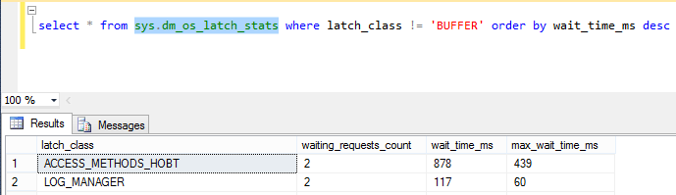
LATCH_* Solutions
Monitor CPU utilization and wait times within SQL Server
Is there relationship between CPU utilization and latch wait times?
If so, review the DMV, sys.dm_os_latch_stats to determine the specific type of latch
In some cases, memory dumps of the process are needed to analyzed with Windows debugging tools

Slide 39

LATCH_* Solutions – Cont.
Query to find which Non-buffer Latch Class is waited on the most
WITH Latches AS (SELECT latch_class, wait_time_ms / 1000.0 AS WaitS, waiting_requests_count AS WaitCount, 100.0 * wait_time_ms / SUM (wait_time_ms) OVER() AS Percentage, ROW_NUMBER() OVER(ORDER BY wait_time_ms DESC) AS RowNum FROM sys.dm_os_latch_stats WHERE latch_class NOT IN ( N'BUFFER') AND wait_time_ms > 0) SELECT W1.latch_class AS LatchClass, CAST (W1.WaitS AS DECIMAL(14, 2)) AS Wait_S, W1.WaitCount AS WaitCount, CAST (W1.Percentage AS DECIMAL(14, 2)) AS Percentage, CAST ((W1.WaitS / W1.WaitCount) AS DECIMAL (14, 4)) AS AvgWait_S FROM Latches AS W1 INNER JOIN Latches AS W2 ON W2.RowNum <= W1.RowNum WHERE W1.WaitCount > 0 GROUP BY W1.RowNum, W1.latch_class, W1.WaitS, W1.WaitCount, W1.Percentage HAVING SUM (W2.Percentage) - W1.Percentage < 95;

Slide 40
LATCH_* Solutions – Cont.
Great article by Paul Randall
Most-common-latch-classes-and-what-they-mean
Top 10
ACCESS_METHODS_DATASET_PARENT
ACCESS_METHODS_SCAN_RANGE_GENERATOR
ACCESS_METHODS_HOBT_COUNT
LOG_MANAGER
TRACE_CONTROLLER
DBCC_MULTIOBJECT_SCANNER
ACCESS_METHODS_HOBT_VIRTUAL_ROOT
FGCB_ADD_REMOVE
DATABASE_MIRRORING_CONNECTION
NESTING_TRANSACTION_FULL

Slide 41
10. IO_Completion
Not as common as the others
Occurs while waiting for I/O operations to complete
Represents non-data page I/Os
Data page I/O completion appear as PAGEIOLATCH_* waits
Occurs when reading from the transaction log
i.e. recovery
Seen when writing intermediate sort buffers to disk
AKA – Big output Buffer (BoB)
Seen in merge joins
When reading/writing merge results from/to disk
Reading / writing eager spool operations to disk

Slide 42
10. IO_Completion Solutions
If wait time for IO_COMPLETION is a significant percentage of the total wait time
Look for system-wide disk bottlenecks
Review Disk Sec/read, Disk Sec/write, & Disk Queues
Read / Write latencies
If disk bottlenecks are found, try the following to reduce wait
Add additional I/O bandwidth, i.e. add faster disks
Balance I/O from busy devices to less busy devices
Use Extended Events - get the queries causing this wait
It's possible the query usually executes well
But the optimizer sometime chooses a bad query plan
If only a few queries, try to tune them
Use the system table-valued function, ‘fn_virtualfilestats’
Check the IoStallMS value
IoStallMS is the cumulative number of milliseconds of I/O waits for a particular file
If IoStallMS is high for one or more files, you have a disk bottleneck
To display IoStallMS, execute the query:
SELECT * FROM ::fn_virtualfilestats(dbid,file#)

Slide 43
Summary
Wait Types provide the best information
About why a SQL statement is running slow
They give you great clues on how to tune it
There are several DMVs showing Wait Types
However no point-in-time view
Can’t tell what happened between 3-4am when something was slow
Use Extended Events to collect the data
Use tools like Solarwinds Database Performance Analyzer (DPA)
Memorize these 10 wait types
What causes them
How to fix them
You’ll have a head start on finding & fixing your database issues

Slide 44
Free TRIAL
Resolve performance issues QUICKLY
Try Database Performance Analyzer FREE for 14 days
Improve root cause of slow performance
Quickly identify root cause of issues that impact end-user response time
See historical trends over days, months, and years
Understand impact of VMware® performance
Agentless architecture, installs in minutes

Slide 45
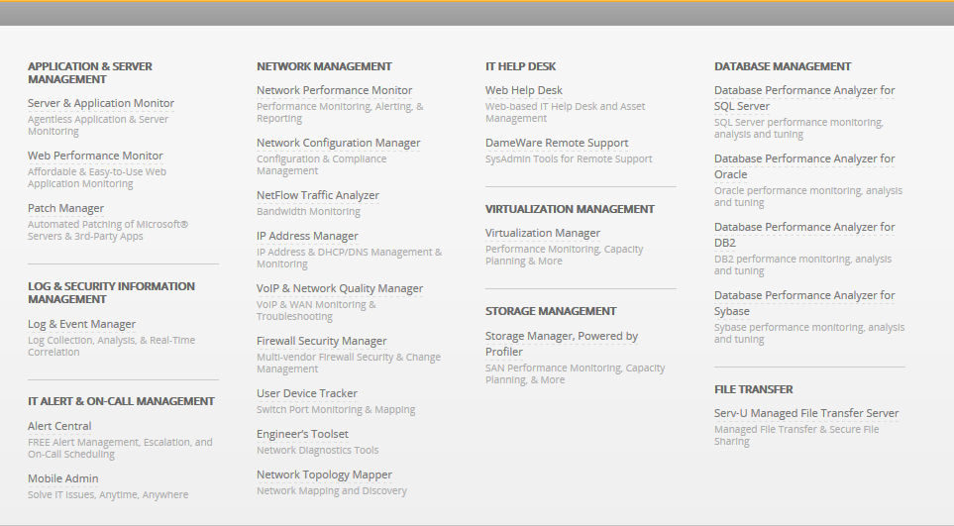
About Solarwinds
45

Slide 46
Thank You!

